Slide 1
SystemVerilog parser Introduction
Chen-Hsiung Liu
2024/5/1

Slide 2
Agenda
Introduce SystemVerilog parser tools and comparison
Example results

Slide 3
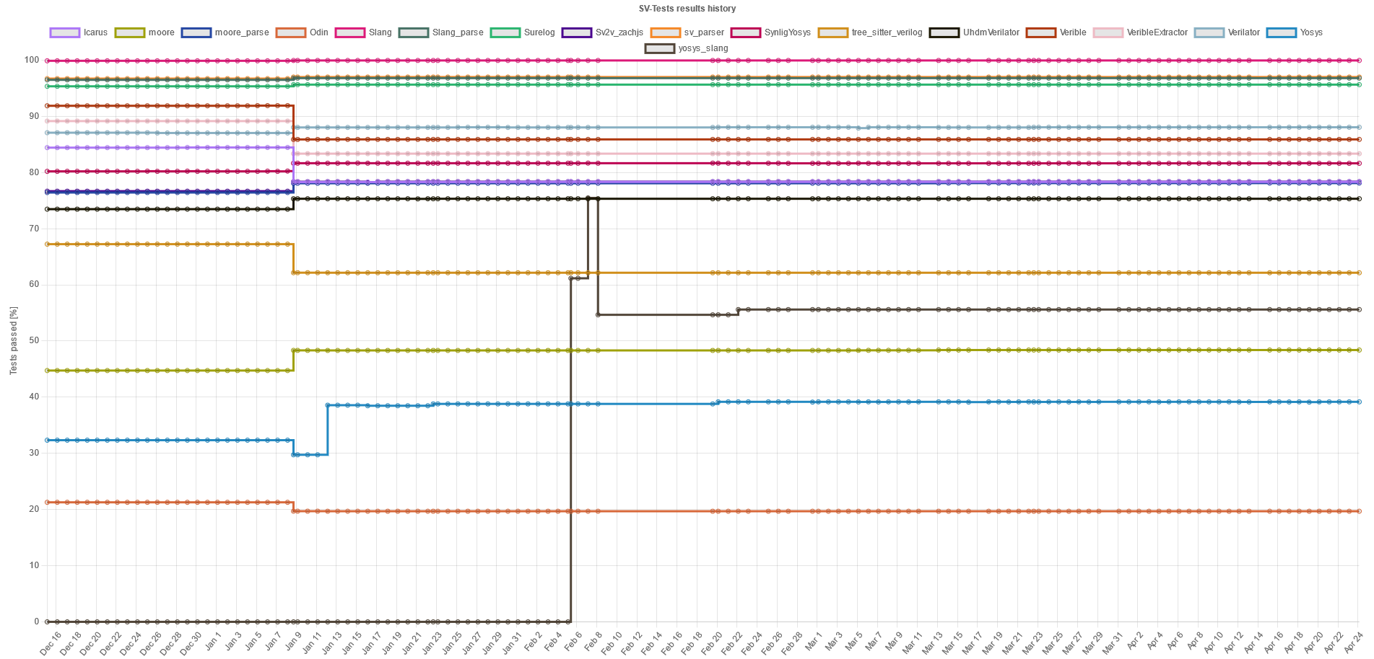
Choice of SystemVerilog parser (1/3)
https://github.com/chipsalliance/sv-tests
Test suite to check compliance with the SystemVerilog standard.

Slide 4
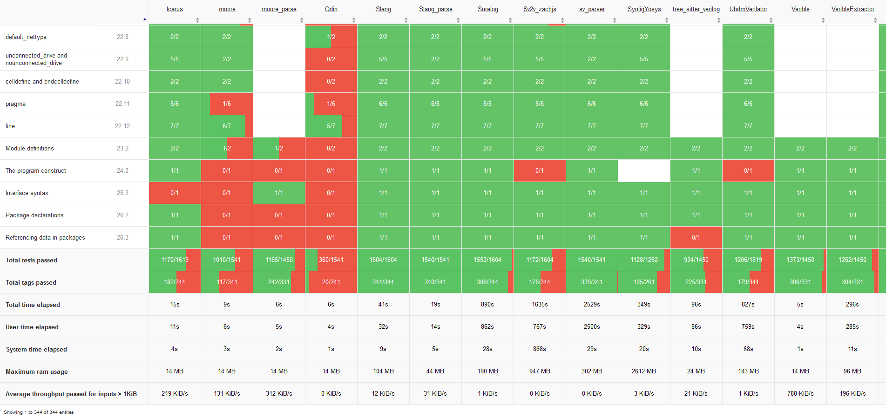
Choice of SystemVerilog parser (2/3)
Detail test report

Slide 5
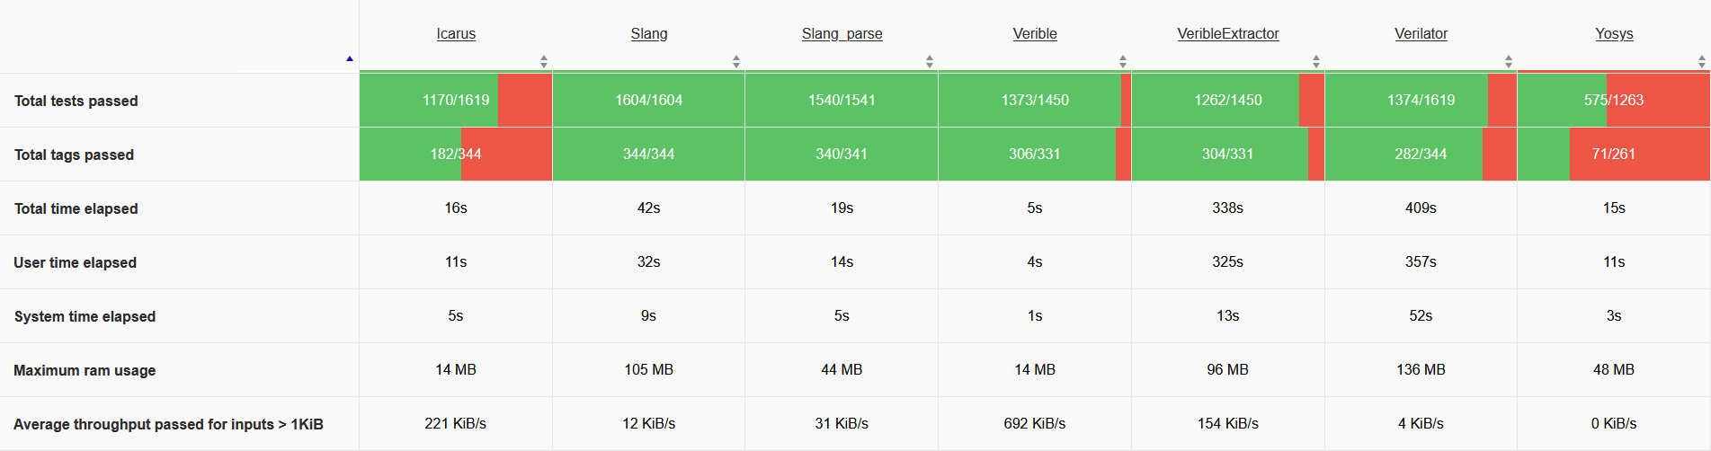
Choice of SystemVerilog parser (3/3)
First, verible-verilog-syntax
Pass 94% syntax in 5s and use only 14MB memory.
Best performance over 690KB/s
Second, Slang
The only one pass 100% SV syntax.
Use 42s and 105MB memory, performance not so good.
For accurate SV syntax check.

Slide 6
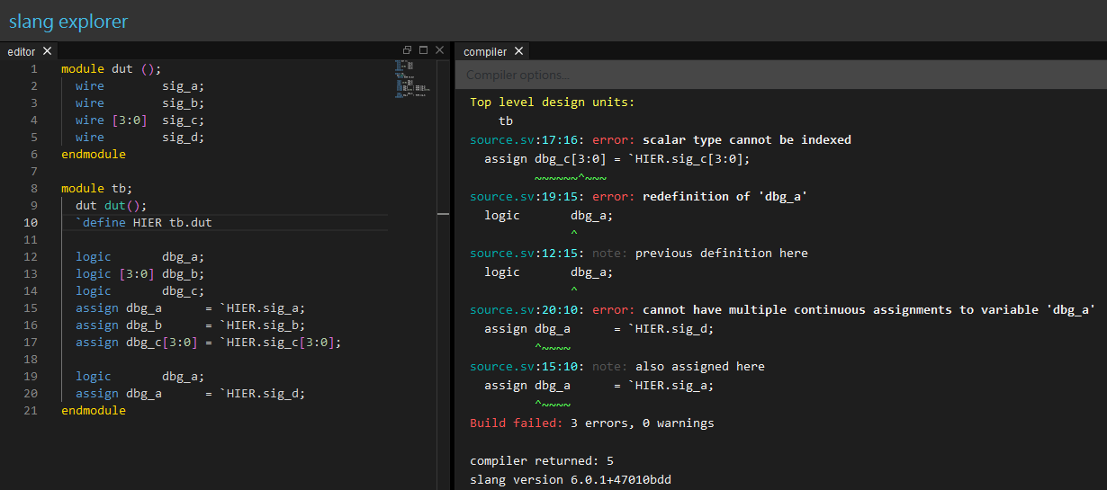
Run slang with example online
Slang explorer (inspired by Compiler Explorer)
`pragma protect directives are validated for correctness.
encrypted text is skipped
Notes:
module dut ();
wire sig_a;
wire sig_b;
wire [3:0] sig_c;
wire sig_d;
endmodule
module tb;
dut dut();
`define HIER tb.dut
logic dbg_a;
logic [3:0] dbg_b;
logic dbg_c;
assign dbg_a = `HIER.sig_a;
assign dbg_b = `HIER.sig_b;
assign dbg_c[3:0] = `HIER.sig_c[3:0];
logic dbg_a;
assign dbg_a = `HIER.sig_d;
endmodule

Slide 7
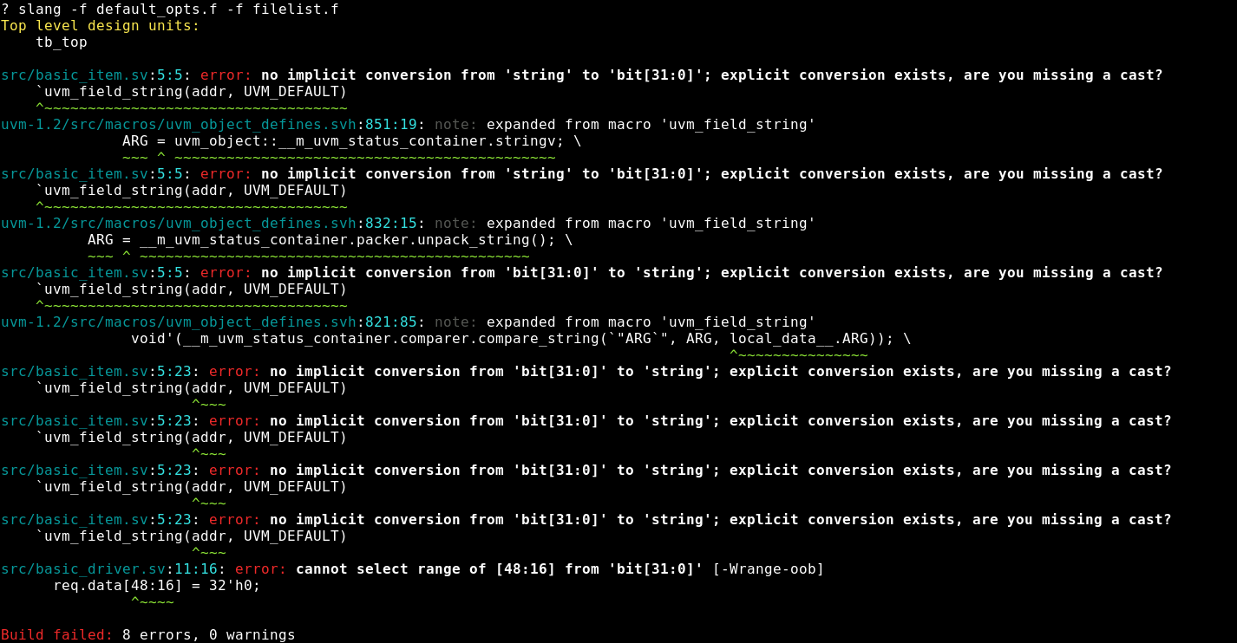
Run slang with UVM example on Linux
UVM example with errors

Slide 8
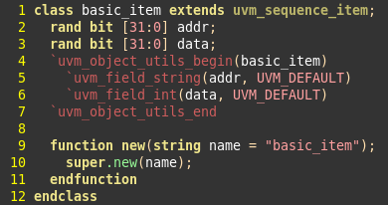
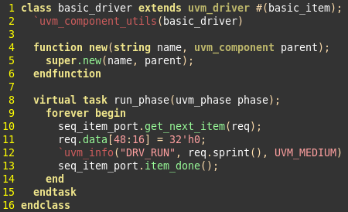
UVM example source
`uvn_field_string in basic_item is incorrect.
Use req.data out of bounds.

Slide 9
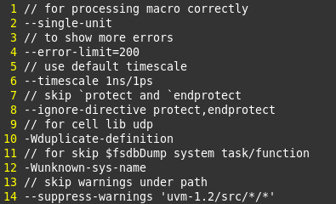
Default options
Use these option to skip not caring errors and warnings

Slide 10
Performance comparison
--lint-only Only perform linting of code, don't try to elaborate a full hierarchy.
 | Simulator | Slang
Case 1 | 4.94 sec 0 warnings | 0.15 sec (33x) 0 errors, 0 warnings
Case 2 | 60 sec 17 warnings | 1.49 sec (40x) 12 errors, 3 warnings
Case 3 | 225 sec 3367 warnings | 17.19 sec (13x) 99 errors, 3325 warnings
Case 4 | 1049 sec 1894 warnings | 97.72 sec (10x) 2281 errors, 2034 warnings
Case 5 | 190 sec 619 warnings | 49.87 sec (3.8x) 1337 errors, 11585 warnings
 |  | 22.93 sec (8x) lint-only 874 errors, 10043 warnings
Notes:
Case 4 use 26GB memory

